Slide 1
JNCIS-ENT
Open Shortest Path First (OSPF)

Slide 2
OSPF Packet Types
2
The building blocks of OSPF

Slide 3
OSPF Packet Types
Link-State Advertisements (LSAs) are flooded reliably using the LSR/LSU/LSAck mechanism
The OSPF header is included with all packets and includes:
The router ID (RID) to uniquely identify the advertising router within the OSPF domain
The Area ID for which the router’s interface is participating
OSPF uses 5 different types of packets:
Type 1
The Hello Packet
Type 2
Database Description Packet
Type 3
Link-State Request
Type 4
Type 5
Link-State Update
Link-State Acknowledge-ment

Slide 4
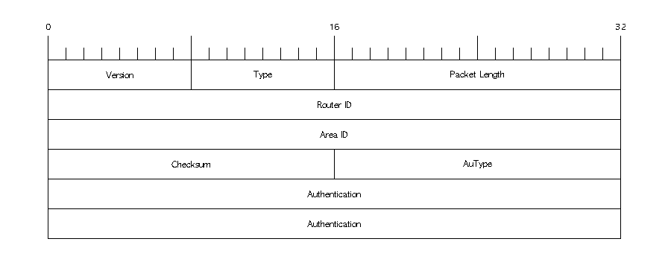
OSPF Packet Header
Header information included in all OSPF packets

Slide 5
OSPF Packet Types: Hello
Multicast Hello packets are used to establish and maintain neighbor relationships.
They are multicast to the destination 224.0.0.5 – All OSPF Routers well-known address
Hello packets contain the following fields:
* These fields must match for 2 neighboring routers to form an adjacency
Network mask*
Hello interval*
Dead interval*
Options*
Neighbors
Router Priority
Designated Router
Backup Designated Router

Slide 6
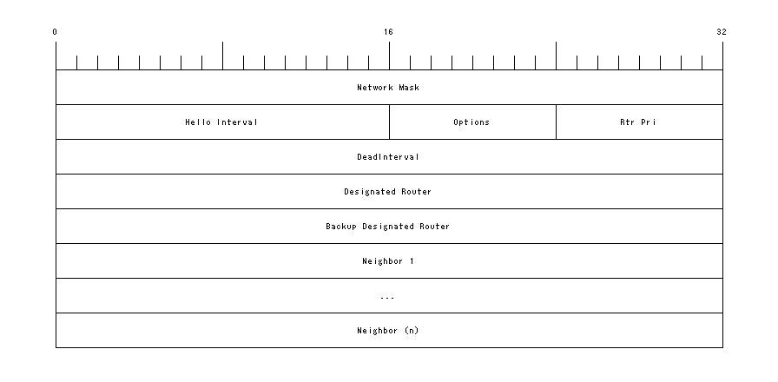
OSPF Packet Types: Hello
Hello packets of OSPF packet type 1

Slide 7
OSPF Packet Types: DD
Database Description packets are used during the adjacency formation process to determine which LSAs either router is not aware of
The router with the highest Router ID becomes the primary in the DD packet exchange and sets the sequence numbers
Sequence numbers are used to ensure reliable transfer of full sequence of DD packets
Database description packets consist of the following 3 main fields:
OSPF Header
Sequence Number
LSA Header

Slide 8
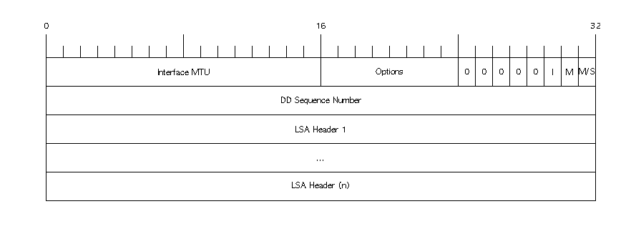
OSPF Packet Types: DD
Database Description packets are of type 2

Slide 9
OSPF Packet Types: LSR
Link-State Requests (LSRs) are created and sent when a router determines its LSDB is stale
This can be in response to an LSA seen in a DD packet which the router is unaware of
This can also be in response to an LSA aging out
An LSR contains the following 4 fields:
OSPF Header
Link-State ID
Link-state type
Advertising Router ID

Slide 10
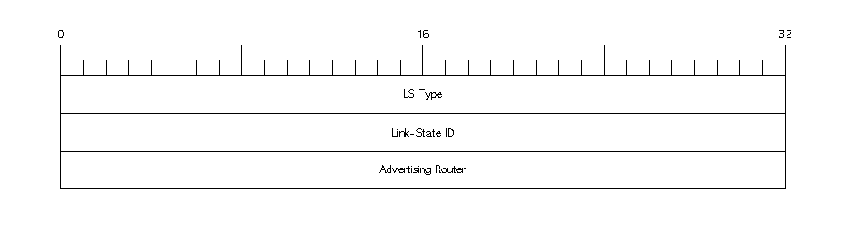
OSPF Packet Types: LSR
Link-State Requests (LSRs) are OSPF packet type 3

Slide 11
OSPF Packet Types: LSU
Link-State Update (LSU) packets are the foundation of OSPF’s exchange of routing information
LSUs carry LSAs. A single LSU can carry multiple LSAs
LSUs are destined to 224.0.0.5 (all OSPF routers) or 224.0.0.6 (All OSPF Designated Routers)
LSUs contain the following 3 fields:
OSPF Header
Number of LSAs contained
Link-state advertisements

Slide 12
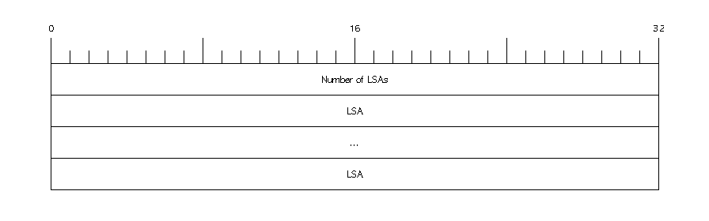
OSPF Packet Types: LSU
Link-State Update (LSU) packets are OSPF packet type 4

Slide 13
OSPF Packet Types: LSAck
Link-State Acknowledgement packets are used to acknowledge successful receipt of LSAs
A single LSAck can acknowledge multiple LSAs
The LSAck contains the following 2 fields:
OSPF Header
Link-state advertisement headers

Slide 14
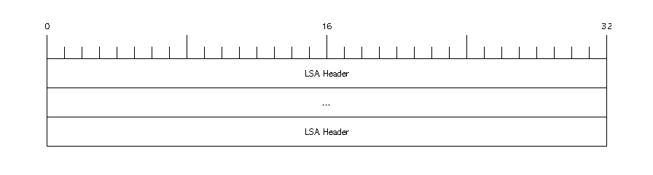
OSPF Packet Types: LSAck
Link-State Acknowledgement packets are type 5

